Slide 1
HMT 801 Travel Agency and Tour Operations
UNIT 4
Travel Entrepreneurship and Sustainable Marketing
Topic
Green Marketing for Tourism
Course Outcome (CO)
CO5: Evaluate the Sustainability of Travel operations and activities of travel bodies and associations

Slide 2
Marketing
“Marketing is a social and managerial process by which individuals and groups obtain what they need and want through creating and exchanging products and value with others”

Slide 3
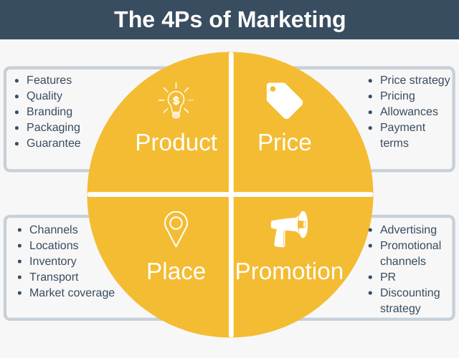

Slide 4
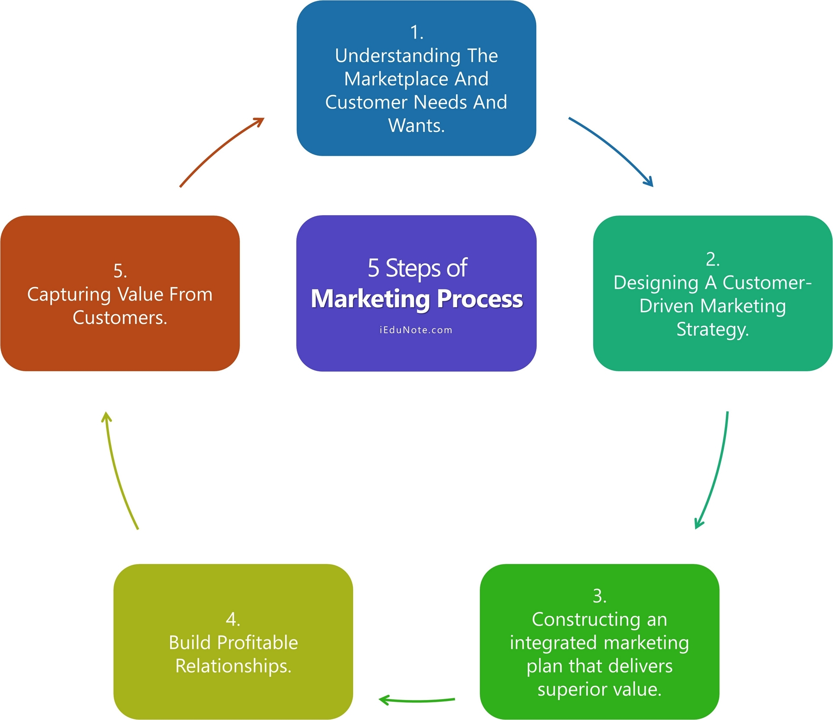

Slide 5
Defenition
Green marketing is a unique category of marketing in which products are promoted based on their environmental benefits.
Concept started in 1980s
The production of eco-friendly products, using sustainable business practices,
Using eco-friendly packaging, and
Creating a marketing campaign that talks about the environment-friendly features of the products

Slide 6
Green marketing is implemented in practice through the application of environmentally acceptable strategies

Slide 7
Green marketing key components
Creating and developing environmentally sensitive market segments
Systematically monitoring, evaluating and auditing all market activities and all product lines, based on the latest environmental requirements and standards;
Redefining quality strategies and product packaging;

Slide 8
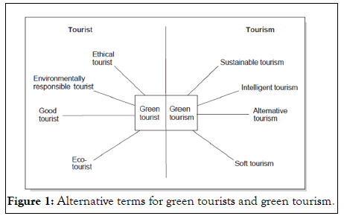
Green tourist and green tourism

Slide 9
Green marketing key components
Redefining strategies of promotional activities and communication with the market and the public at large, with environmental groups and organisations, with individual countries, etc.;
Creating new environmental standards and launching new environmental initiatives
Embracing environmental forms of product labelling.

Slide 10
Three major effects of green marketing on businesses
Cutting back costs.
Differentiation relative to rivals.
Revitalisation of a business.

